Slide 1
Kidney-Genetics A reproducible and curated database of kidney disease genes Dr. Nina Rank, 06.10.2023
Department of Nephrology and Medical Intensive Care
Berlin Institute of Health (BIH)

Slide 2
Objective
10 – 30% of patients with kidney failure have a family history ¹
~ 700 mendelian disease genes
Problem: no unified and up-to-date database of kidney associated genes
Solution: Kidney-Genetics
Solution: Kidney-Genetics
standardized
automated
publicly accessible
regularly updated
¹ Groopman et al. Genomic medicine for kidney disease. Nature Reviews Nephrology, 2018

Slide 3
Methods
PanelApp
Literature
Diagnostic Panels
OMIM/Orphanet
PubTator
Evidence criteria
Candidate genes
High-evidence genes

Slide 4

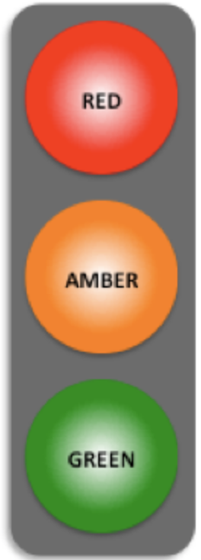


Methods
PanelApp
Literature
Diagnostic Panels
OMIM/Orphanet
PubTator
Not enough evidence
Moderate evidence
“Renal” or “Kidney” or “Nephro”
High evidence
25 panels
546 genes
or
Evidence filter
444 genes

Slide 5
Methods
PanelApp
Literature
Diagnostic Panels
OMIM/Orphanet
PubTator
16 published kidney
gene lists
Groopman et al., NEJM, 2019
Claus et al., AJMG, 2022
Bleyer et al., Am J Nephrol, 2022
…
822 genes
gene in ≥ 2 gene lists
Evidence filter
491 genes

Slide 6
Methods
PanelApp
Literature
Diagnostic Panels
OMIM/Orphanet
PubTator
10 Diagnostic Panels
Centogene Nephrology
Mayocliniclabs Renal Genetics
Blueprintgenetics Nephrology
…
911 genes
gene in ≥ 2 panels
Evidence filter
540 genes

Slide 7
Methods
PanelApp
Literature
Diagnostic Panels
OMIM/Orphanet
PubTator
HP:0010935
“Abnormality of the upper urinary tract“
779 genes
none
Evidence filter
779 genes

Slide 8
Methods
PanelApp
Literature
Diagnostic Panels
OMIM/Orphanet
PubTator
“kidney disease” or “renal disease”
AND
gene or syndrome
AND
variant or mutation
2032 genes
gene in ≥ 3 publications
Evidence filter
713 genes

Slide 9
Results
PanelApp
Literature
Diagnostic Panels
OMIM/Orphanet
PubTator
546
822
911
779
2032
2,906 genes
Evidence filter
444
491
540
779
713
1454 genes
861
1015 candidate genes
439 high-evidence genes
154
177
135
127
1
2
3
4
5
Evidence Count

Slide 10
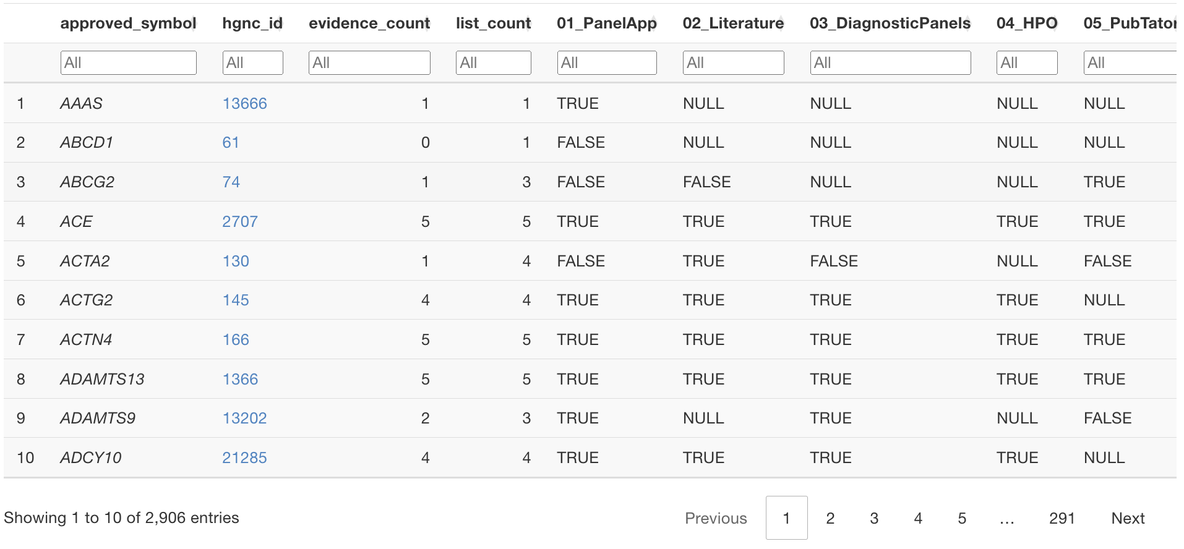
Where to find Kidney-Genetics?
www.kidney-genetics.org

Slide 11
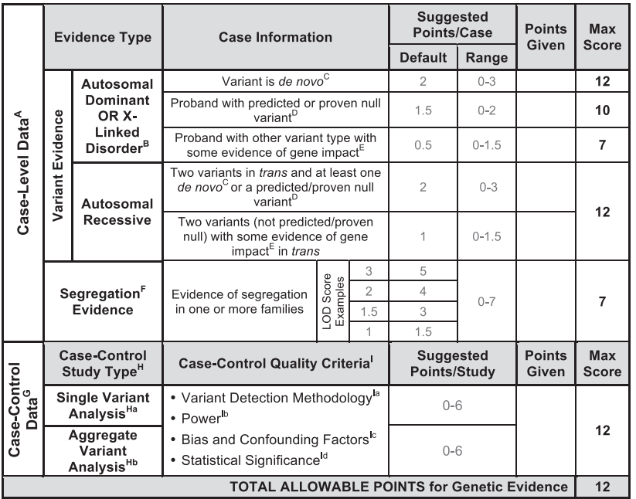
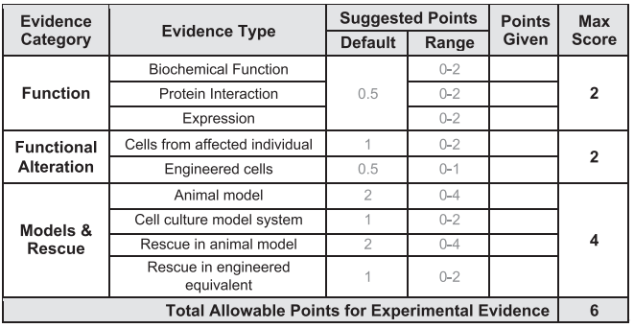
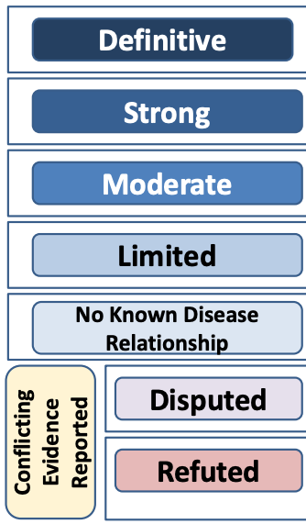
What’s next? – Manual curation of the 439 high-evidence genes
curation available
ClinGen score
Genetic evidence + Experimental evidence => Classification
Rehm et al. ClinGen The Clinical Genome Resource. NEJM, 2015

Slide 12
What’s next? – Manual curation of the 439 high-evidence genes
curation available
no curation
ClinGen score
Manual curation
Genetic evidence
Experimental evidence
Variant information
Population DB
OMIM/MONDO
Animal models
Protein-protein-interactions
Expression data
Curated list of high-evidence genes
Rehm et al. ClinGen The Clinical Genome Resource. NEJM, 2015

Slide 13
What’s next? – Phenotypic grouping
X-linked
syndromic
…
aut-rec
non-syndromic
aut-dom
cancer
complement
early-onset
late-onset
tubulopathy
glomerulopathy
congenital
ciliopathy
CAKUT

Slide 14
What’s next? – Phenotypic grouping
aut-rec
non-syndromic
gene X
early-onset
late-onset
glomerulopathy

Slide 15





Thank you for your attention!
Constantin Wolff
Prof. Dr. med. Jan Halbritter
Dr. med. Bernt Popp
Funding

